Slide 1
Mapping Existing Data to Graphs
ETL: Extract, Translate, Load
Finding common attributes between existing data and resource graphs
Existing Dataset Field
“RESOURCE_NAME”
value = ‘Lungshan Temple’
Arches Field(s)
“NAME.E41”
value = ‘Lungshan Temple’
“NAME_TYPE.E55”
value = ‘Primary’

Slide 2
Data Import Workflow
2 formats can be loaded directly into Arches…
Shapefile (.shp)
Standard GIS data exchange format
Must be accompanied by a configuration file, which is used to map fields to the appropriate database entities.
.arches file
Comma Separated Values (CSV)
Holds all resource and attribute information in a single file
Can be paired with a .relations file to create resource-to-resource relationships during load

Slide 3
Data Import Workflow
Creating a .arches file…
Identify existing data formats
Excel spreadsheets (.xls/.xlsx)
Database tables (.dbf)
Access databases (.mbd)
ESRI geodatabase feature classes/tables (.gdb)
Use software (Excel, Access) or programming (Python, Ruby, Javascript) to manipulate data
Export to CSV, rename as .arches/.relations

Slide 4
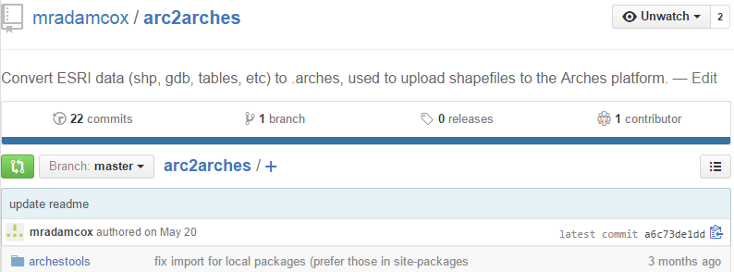
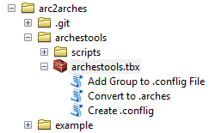
Data Import Workflow
Cane River example…
Existing data:
Shapefiles
Geodatabase feature classes/tables
Created set of ArcGIS tools (using Python) to migrate these data types to a .arches file
https://github.com/mradamcox/arc2arches

Slide 5
System Configuration
…basic configuration that all installations should consider
Customize logos and homepage

Slide 6
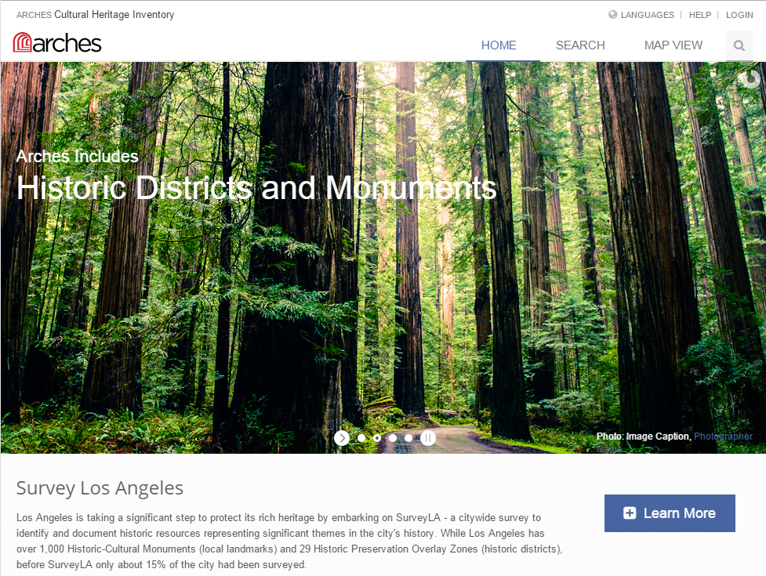
Default HOME page…

Slide 7
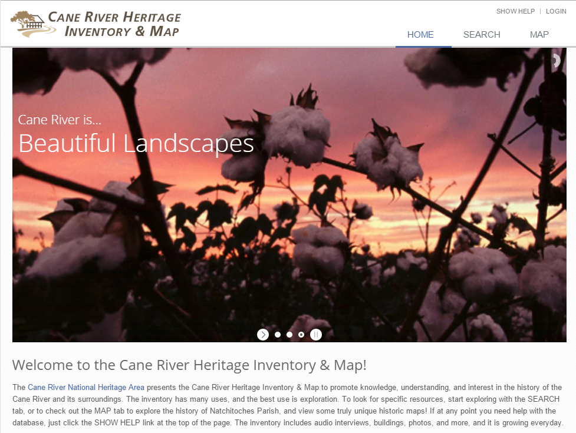
…re-configured HOME page

Slide 8
System Configuration
…basic configuration that all installations should consider
Customize logos and homepage
Re-center MAP VIEW

Slide 9
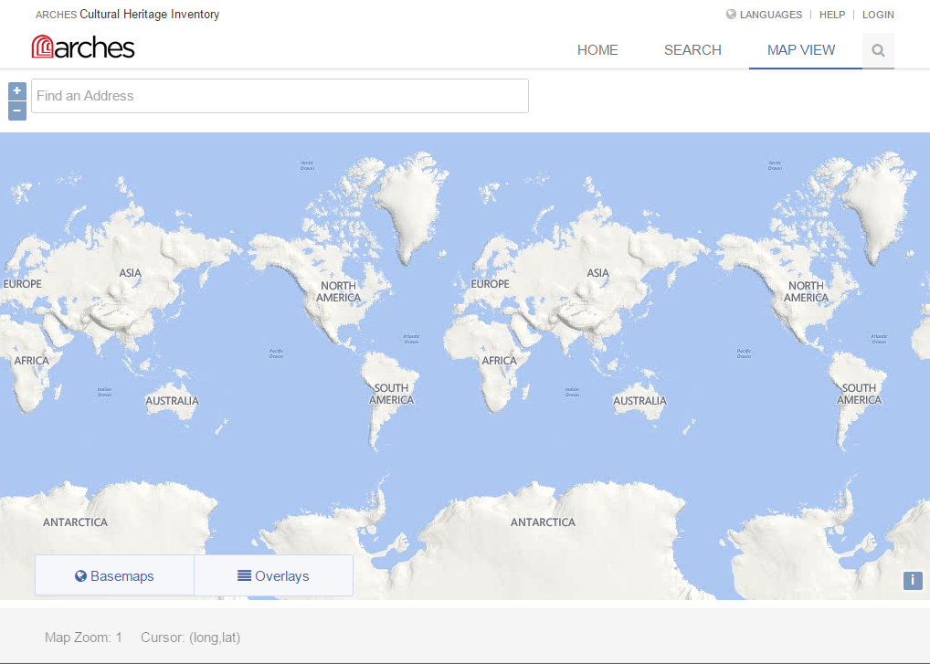
Default MAP VIEW…

Slide 10
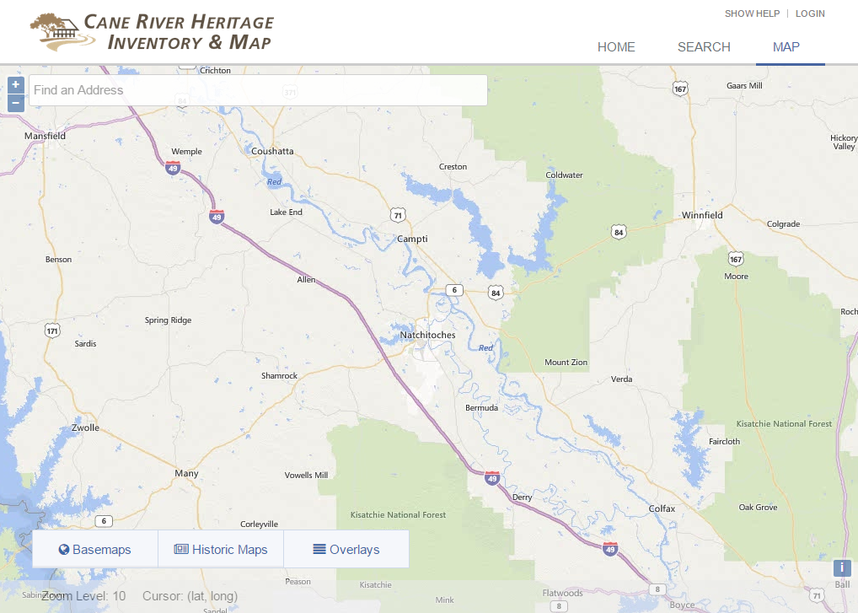
…re-centered MAP VIEW

Slide 11
System Configuration
…basic configuration that all installations should consider
Customize logos and homepage
Re-center MAP VIEW
Adding basemaps and overlays
Use existing tilesets (OpenStreetMap)
Use existing Web Map Service (WMS)

Slide 12
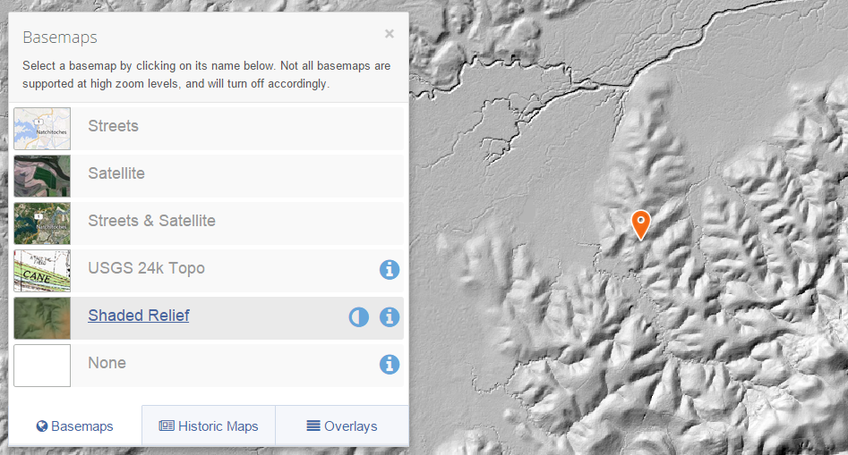
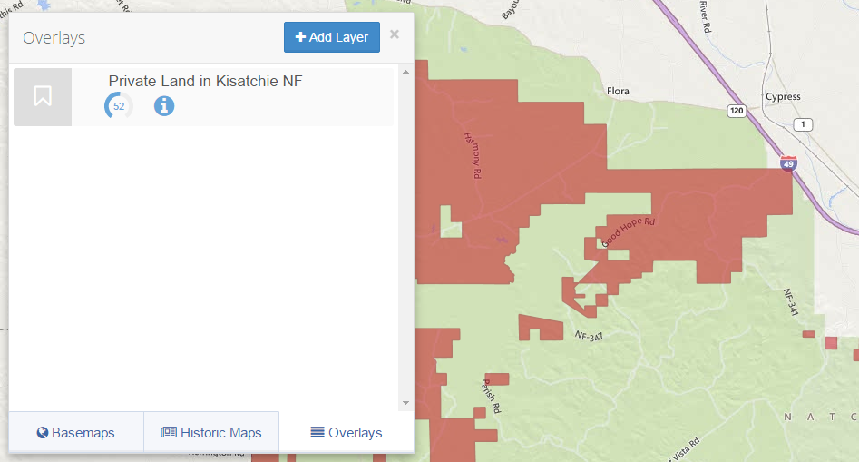
Add Extra Basemaps
- Find alternative basemaps
OpenStreetMap
- Cane River example
created shaded relief,
added as basemap layer
Add Extra Overlays
- Find useful overlays
show lines/features not
present on basemaps
- Cane River example
added boundaries of
private land in nearby
National Forest

Slide 13


Server Considerations
Arches is server-side software, not client software
So, where should the server be?
In-House Hosting
Purchase/allocate local server, integrate with existing infrastructure
Purchase cost, maintenance/administration costs
Cloud Hosting
Monthly/yearly subscription fees
Amazon Web Services (AWS)
DigitalOcean
Many more cloud options (geographic location may be a consideration)

Slide 14
In-house hosting, Cane River example…
Dedicated Local Server
(Housed at National Center for Preservation Technology and Training)
Domain Name
-- crhim.canerivernha.org
-- Created subdomain from existing website, www.canerivernha.org
-- Holds Arches code
-- Holds PostGIS database
-- Holds webserver to serve Arches through the internet
-- Holds all uploaded media, photos, audio resources, etc.
Browser
View and interact with Arches
-- Chrome, Firefox, IE > 10, Safari
-- Users require no extra software

Slide 15
Cloud hosting, Armed Forces Retirement Home example...
AWS EC2 Instance
($10 - $500/mo + $0.10/gb-mo)
AWS Route 53
($0.50/mo)
-- DNS hosting for domain name
-- Holds Arches code
-- Holds PostGIS database
-- Holds webserver to serve Arches through the internet
AWS S3 Bucket
($0.03/gb-mo)
Store uploaded media:
-- photos
-- scanned documents
-- audio/visual resources
Browser
View and interact with Arches
-- Chrome, Firefox, IE > 10, Safari
-- users require no extra software
-- pull media files straight from S3

Slide 16
Further Customizations
…altering the GUI (Graphical User Interface)
Remember, Arches is a framework that exists underneath a website.
The Graphical User Interface (GUI) of the website can be altered substantially to create a new user experience
Two examples from Cane River…

Slide 17
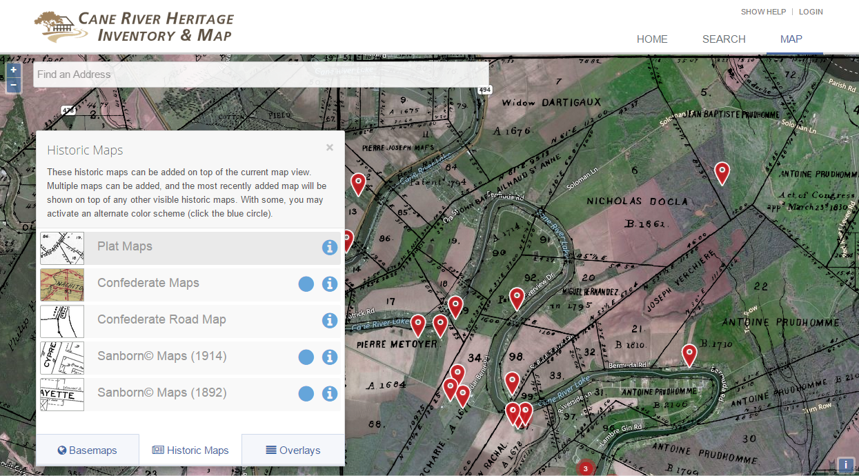
…added Historic Maps as overlays

Slide 18
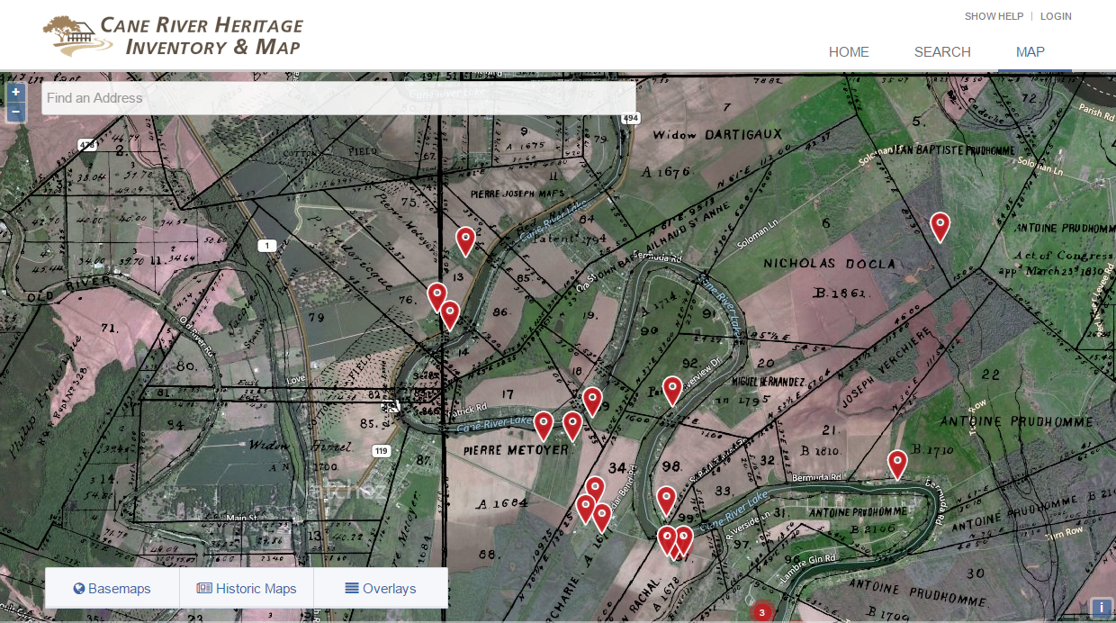
…added expandable help menus on each page

Slide 19
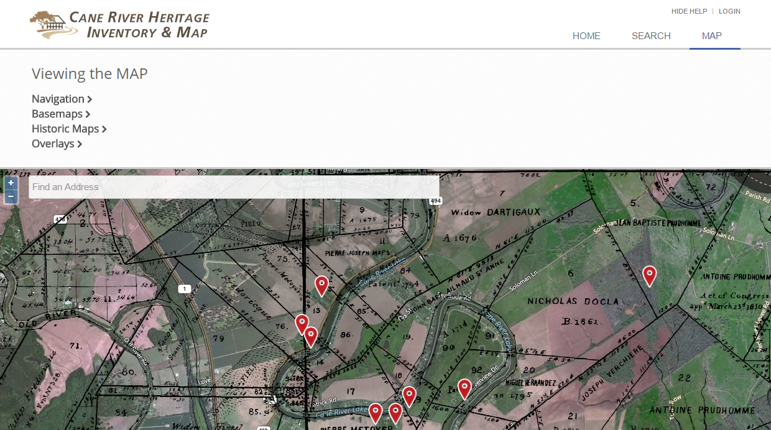
…added expandable help menus on each page

Slide 20
Further Customizations
…altering the database structure
Resource Graphs can be modified or completely rewritten
Change the structure of existing resource graphs
Create completely new resource graphs
Two-part process…

Slide 21
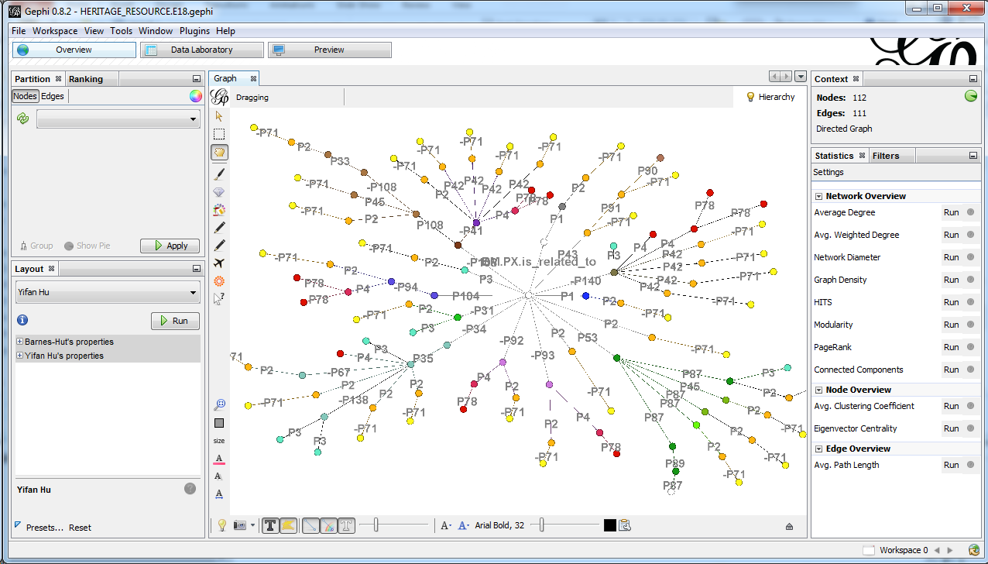
Part 1: Alter/Export Resource Graphs using Gephi
Free and open source software for data modeling

Slide 22
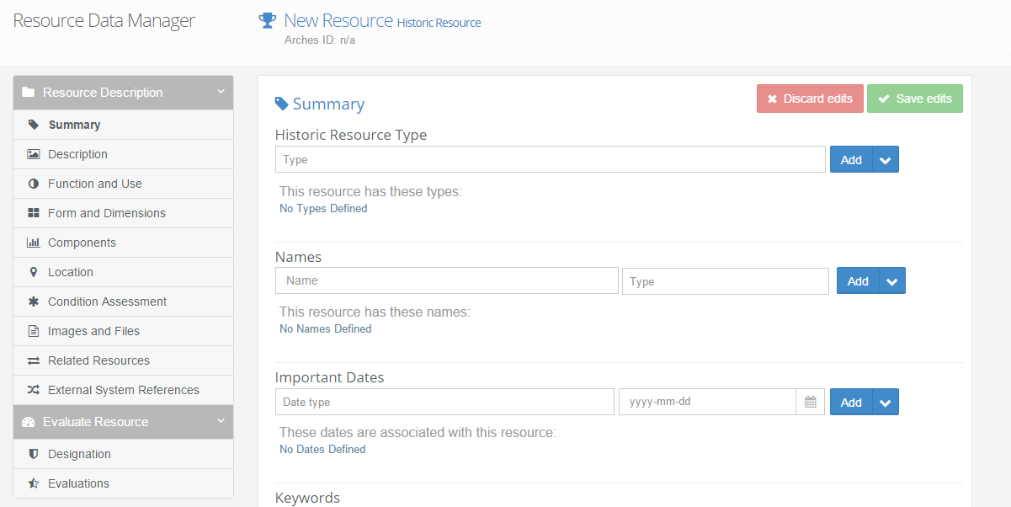
Part 2: Update Arches data input forms
Website must be updated to support new data structure
Use HTML, JavaScript, and CSS to add, remove, or modify input forms

Slide 23
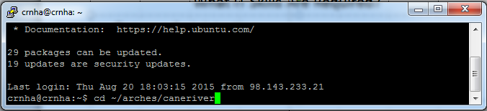
What IT Skills Are Required?
Server Configuration
Command Line Interface/Terminal
Migrating data
GIS experience (QGIS, ArcGIS, etc.) for spatial data
General database and data manipulation experience
Python, Ruby, etc. for making large data conversions
Customizing the application
Python, especially with Django web framework
HTML/CSS for website look and contents
JavaScript for website interaction and web map
OpenLayers3, knockout
Useful Extras…
GeoServer for creating new map layers
PostGIS/SQL and ElasticSearch for search customizations
BitBucket/GitHub for creating and managing remote repositories

